Slide 1

Rutgers Data Science Bootcamp
Project 1
Group 2:
Kevin Buron
Kelly Curtiss
Angel Popa
Tunde Salisu

Slide 2


Overview
To identify a relationship between the graduation rate and crime rate across the United States.
Does graduation rate impact crime rate?
Is the correlation more significant at a state level or national level?
Does graduation rate impact specific types of crimes?

Slide 3
Data Sources, Clean Up & Analysis Process
National Center for Educational Statistics; Common Core of Data: America’s Public Schools:
https://nces.ed.gov/ccd/data_tables.asp#Page:1
FBI Crime Statistics using the crime-data-explorer:
https://crime-data-explorer.fr.cloud.gov/downloads-and-docs
Jupyter Notebook:

Slide 4
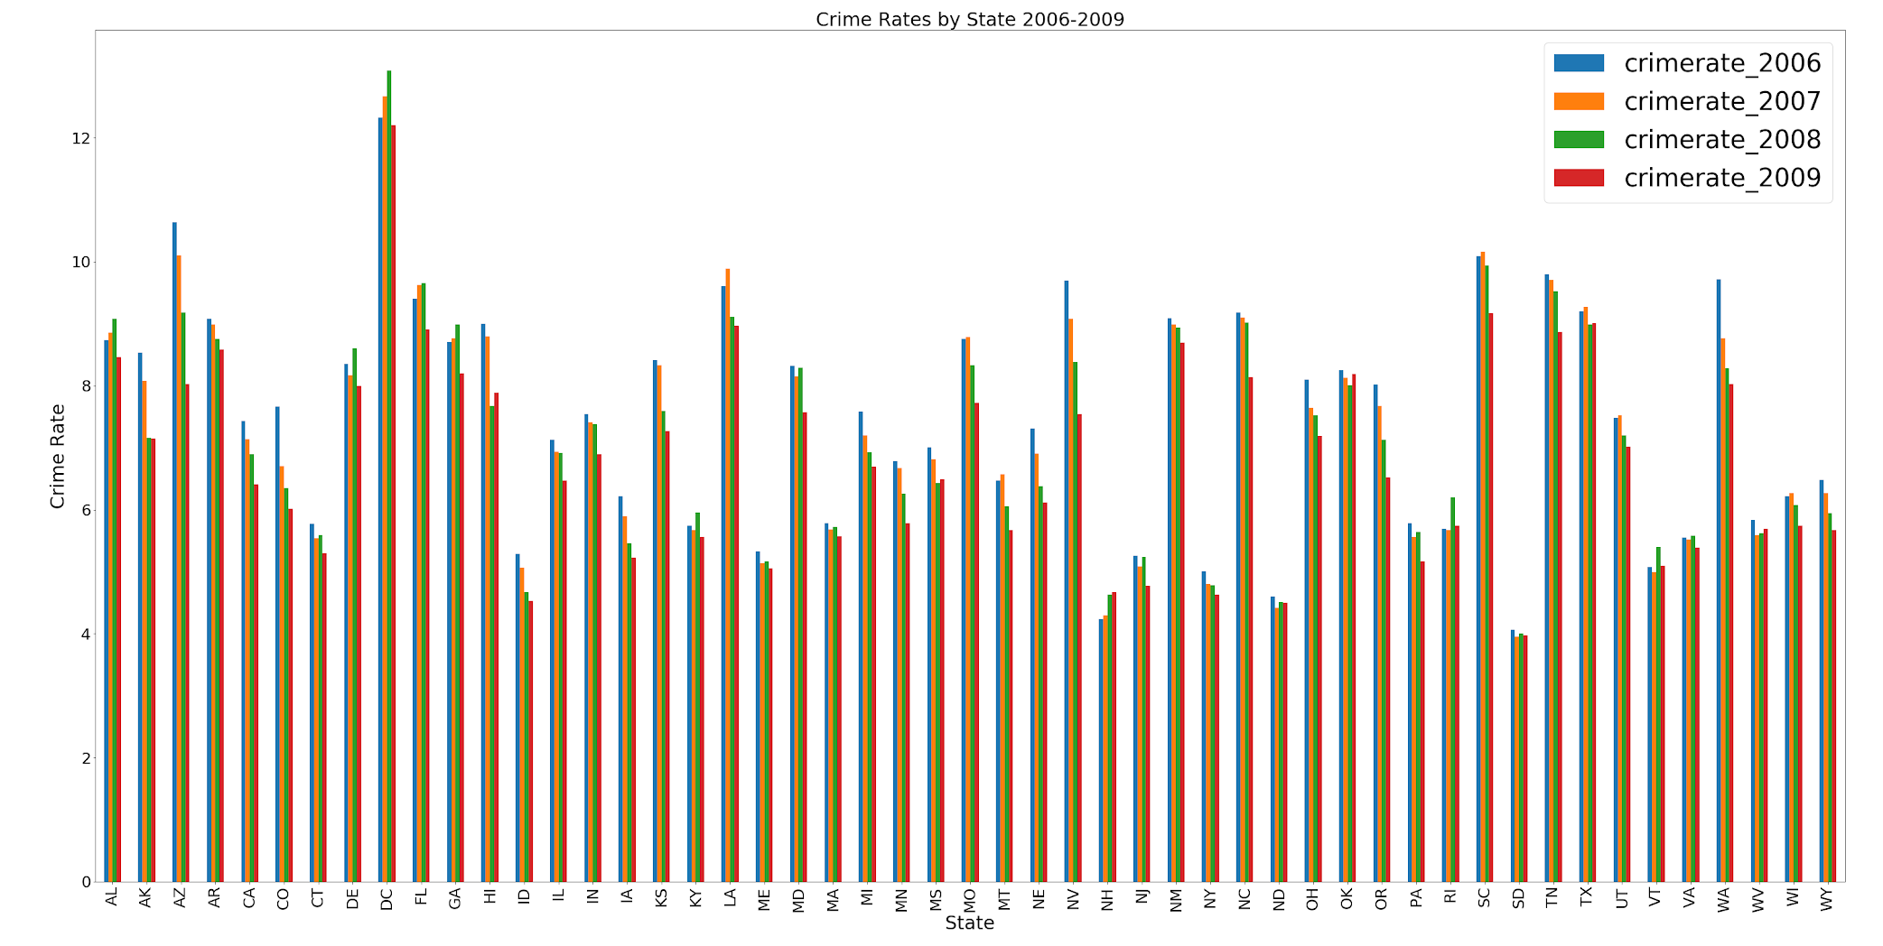
US States Crime Rates 2006-2009
Notes:
Notable States with Highest Crime Rates: AZ, DC, LA, NV, SC, TX, WA
Notable States with Lowest Crime Rates: CT, ID, ME, NH, NJ, NY, ND, SD

Slide 5
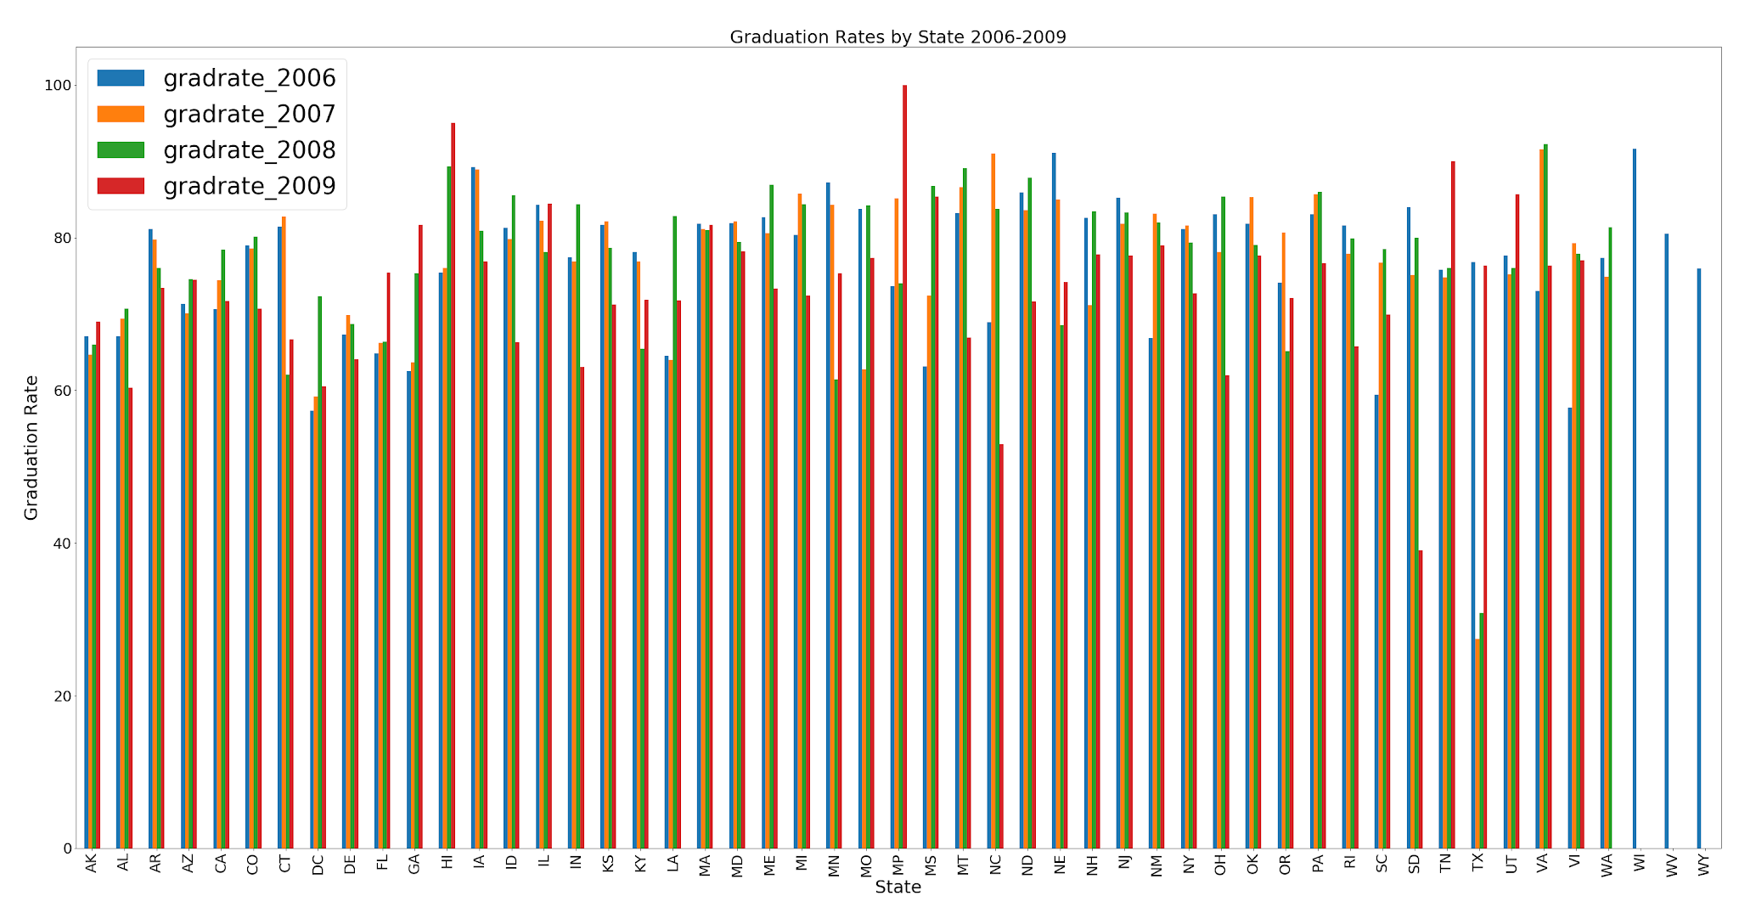
US States Graduation Rates 2006-2009
Notes:
Notable States with Highest Grad Rates: AK, CT, HI,
Notable States with Lowest Grad Rates: DC, TX

Slide 6
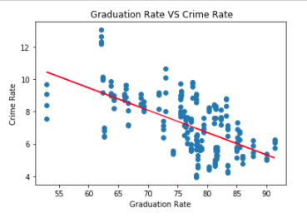
Graduation Rates Vs. Crime Rates 2006-2009
The correlation value of -0.61 shows that there is a relationship between the graduation rates and crime rates in the US.
As the graduation rates increase the crime rates decrease.
Notes:
Correlation: -0.61

Slide 7
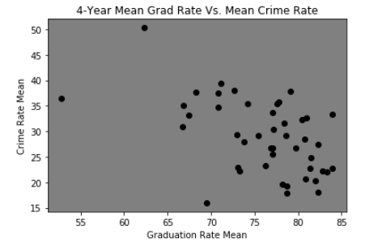
Mean Graduation Rates Vs. Mean Crime Rates 2006-2009
Notes:
The correlation between both factors is -0.51

Slide 8
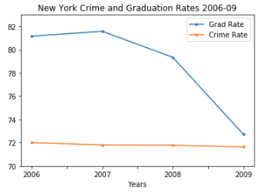
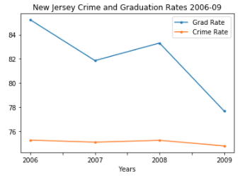
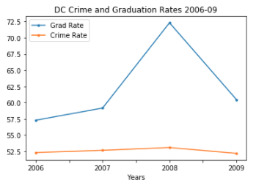
Focus on NY , NJ , & DC
When looking at individual states, not all states follow the national trend.
NY and NJ demonstrate a decreasing graduation rate along with a decreasing crime rate over the 4 years.
*Note: crime rates were translated vertically to improve the visual representation of each comparison.

Slide 9
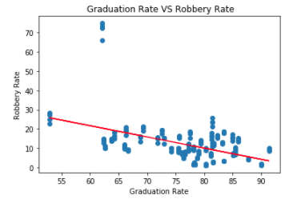
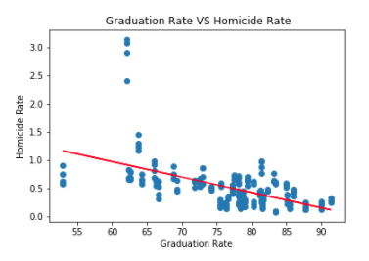
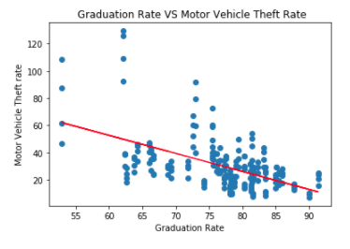
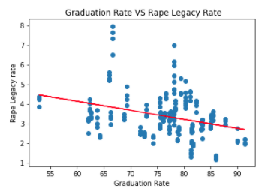
Graduation Rates Vs. Specific Crime Rates
Robbery: Correlation: -0.44
Homicide: Correlation: -0.52
Motor Vehicle Theft: Correlation: -0.54
Rape: Correlation: -0.32
Notes:
Robbery: Correlation: -0.44
Homicide: Correlation: -0.52
Motor Vehicle Theft: Correlation: -0.54
Rape: Correlation: -0.32

Slide 10
Conclusions & Additional Questions
Resulting From Analysis
Conclusion:
Overall, when the graduation and crime data is analyzed on a national level, there is a negative correlation between graduation rates and crime rates. However, when you look at individual states, this doesn’t always hold true. Additionally, when you look at specific types of crime rates at the national level, there is a negative correlation with a few exceptions having weaker negative correlations.
These findings confirm our initial thoughts that there is a relationship between higher graduation rates and lower crime rates. However, the exceptions that we discovered created new questions for future possible analysis projects. For example:
Do rates of diagnosed mental illness relate to crime rates?
Do rates of political unease/protests relate to crime rates?
Do socio-economic levels and poverty rates relate to crime rates?

